Slide 1
Building Agentic RAG Systems with LlamaIndex
Creating intelligent AI agents using retrieval and generation
Notes:
AI-generated content may be incorrect. --- Welcome to this presentation on building agentic retrieval-augmented generation systems using LlamaIndex, guided by Jerry Liu. We'll explore how AI-driven decision systems can be enhanced with retrieval and generation techniques to create smarter, autonomous agents.

Slide 2
Course Agenda
Title Slide: Building Agentic RAG Systems with LlamaIndex
Course Overview
Introduction to RAG Systems
Getting Started with LlamaIndex
Data Preparation and Integration
Model Development
Agentic Behaviors
Training and Optimizing
Implementing RAG Systems
Evaluation and Iteration
Advanced Topics
Project Workshop
Benefits of Agentic RAG
Notes:
Today’s agenda covers an overview of the course, an introduction to RAG systems, how to get started with LlamaIndex, data preparation, model development, agentic behaviors, training, implementation, evaluation, advanced topics, a project workshop, and the benefits of agentic RAG.

Slide 3
Title Slide: Building Agentic RAG Systems with LlamaIndex
Notes:
This slide introduces the course and its author, Jerry Liu. It sets the stage for exploring AI-driven decision systems, featuring thematic visuals to engage and orient the audience.

Slide 4

By Jerry Liu | Explore AI-Driven Decision Systems
AI in Decision-Making
AI systems improve decision-making by analyzing data and generating actionable insights autonomously.
Combining Retrieval and Generation
The integration of retrieval with generation enhances AI's capability to provide accurate and relevant decisions.
Notes:
--- Jerry Liu leads this exploration into how AI can be leveraged for decision-making processes. The focus is on combining retrieval and generation to enhance AI capabilities, creating systems that make more informed and autonomous decisions. Image source: Microsoft 365 content library

Slide 5
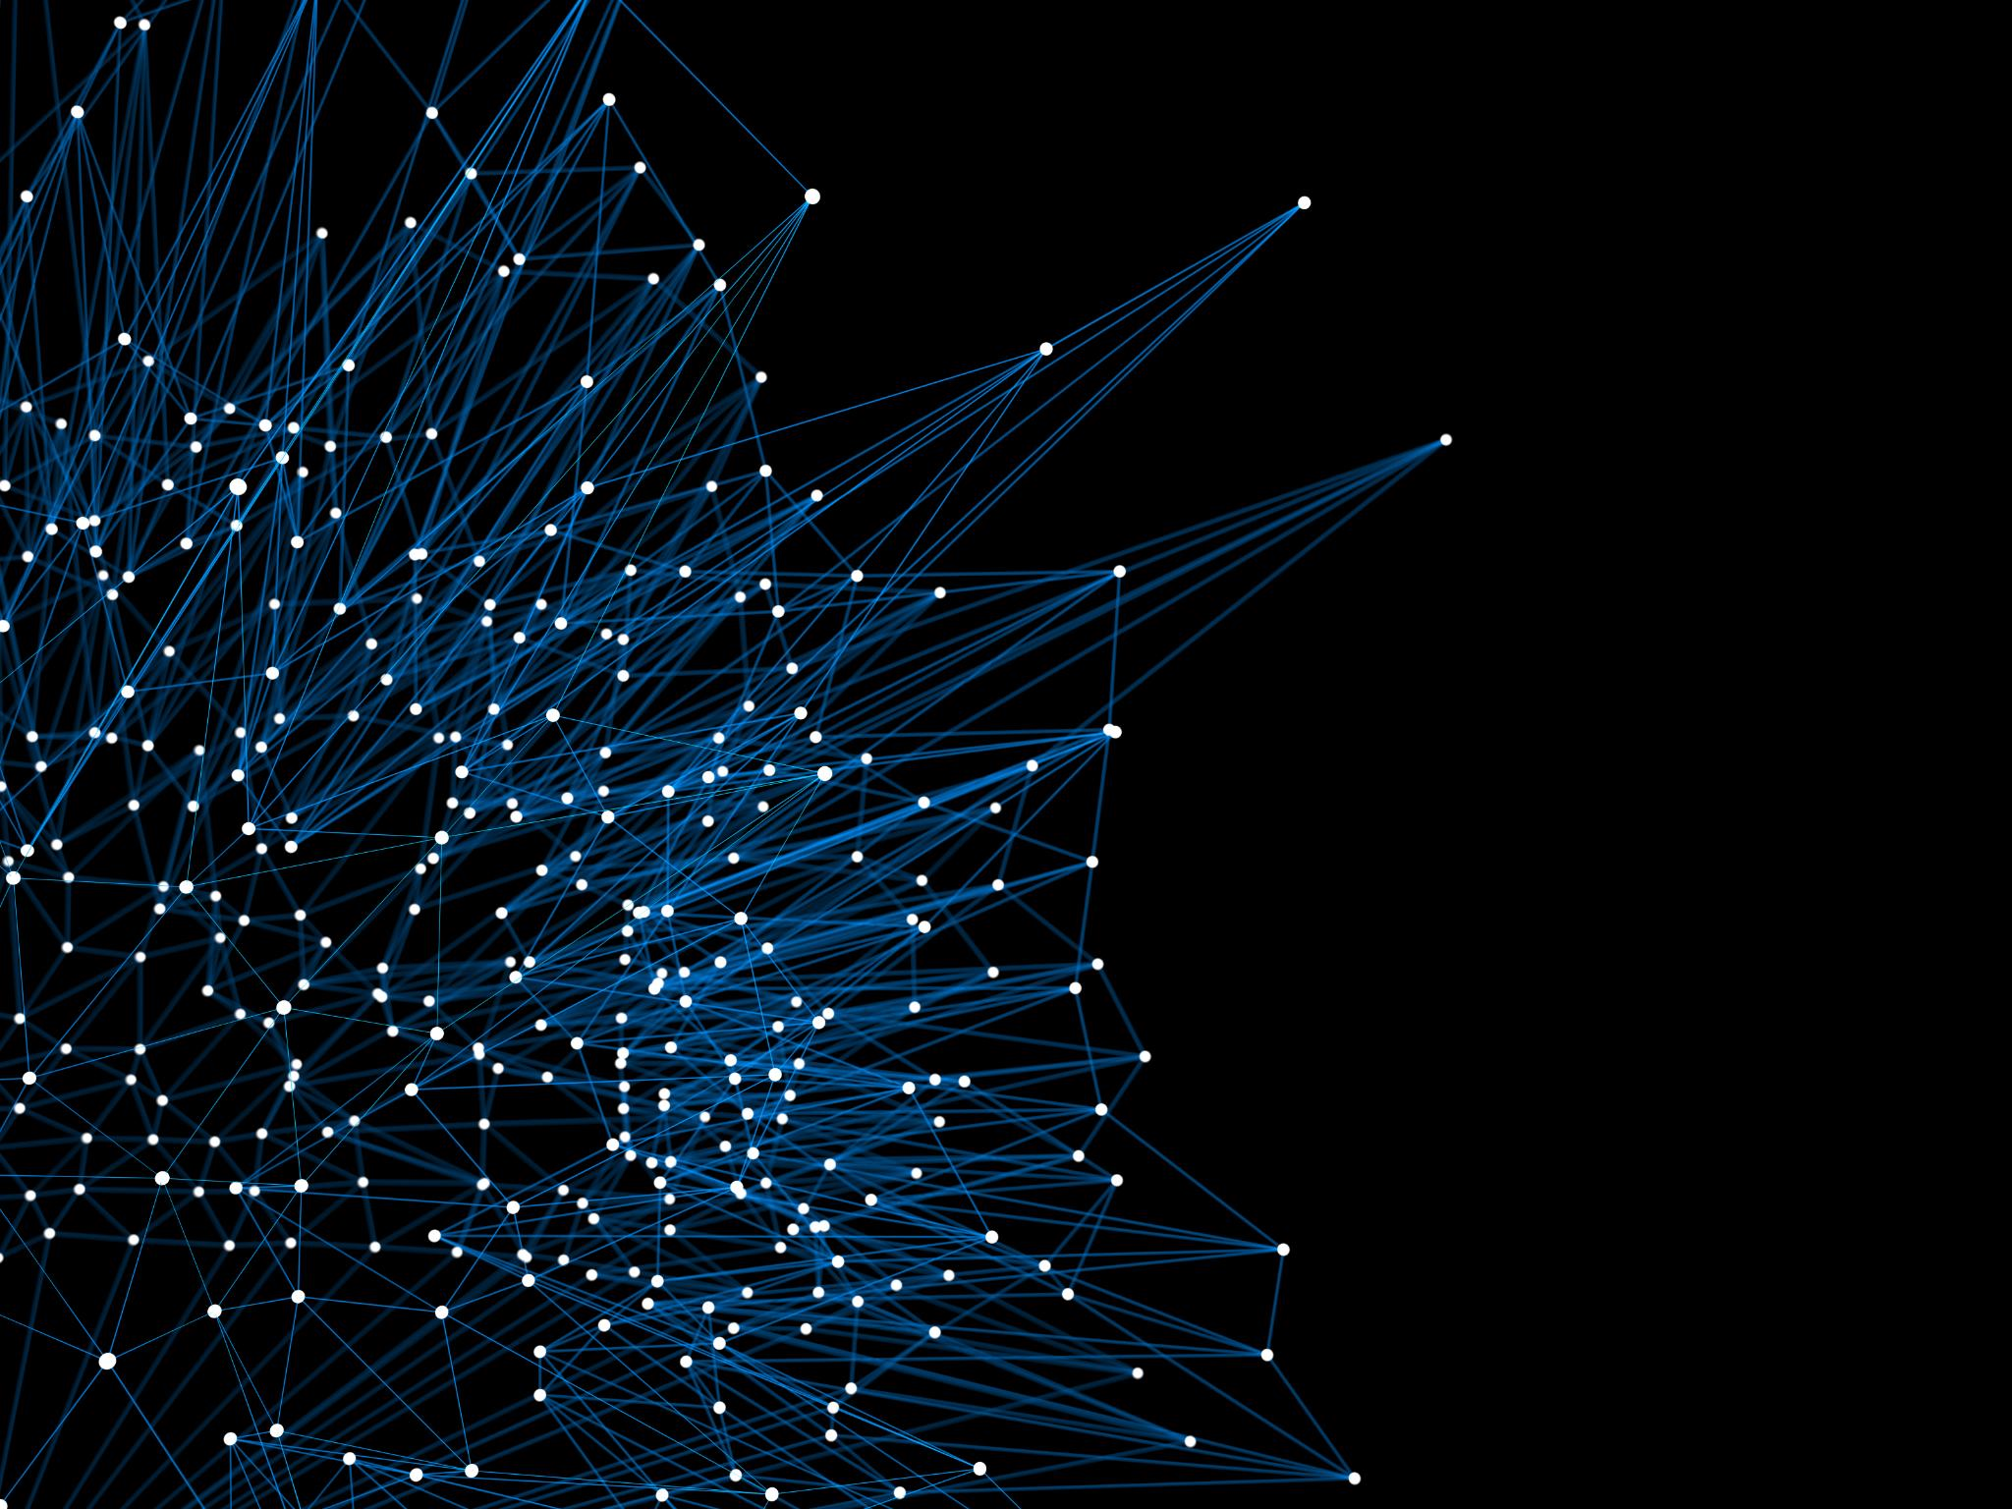
Visual: AI + Decision Systems Thematic Image
AI Integration
Illustrates how artificial intelligence integrates with decision-making systems to enhance efficiency and accuracy.
Decision Systems Visualization
Shows a visual concept of decision systems influenced by AI for better contextual understanding.
Notes:
--- This slide features a visual representation of AI integrated with decision systems, illustrating the core theme of the course and helping to contextualize the technical content. Image source: Microsoft 365 content library

Slide 6
Course Overview
Notes:
In this section, we outline the learning objectives: building agentic retrieval-augmented generation systems using LlamaIndex. The course combines theory and practice to empower participants with the skills to develop context-aware AI agents.

Slide 7

Learn to Build Agentic Retrieval-Augmented Generation (RAG) Systems Using LlamaIndex.
Course Objective
The course empowers learners to build advanced RAG systems that combine language models with real-time data retrieval.
Enhancing Language Models
RAG systems improve language model accuracy by integrating up-to-date and relevant external information dynamically.
Agentic Autonomy
The systems enable autonomous decision-making by allowing AI to retrieve and utilize information independently.
Notes:
--- This content slide emphasizes the key goal of the course—enabling learners to create RAG systems that enhance language models with real-time data retrieval for improved accuracy and autonomy. Image source: Microsoft 365 content library

Slide 8

Visual: AI Workflow Illustration
Data Flow in AI Workflow
The AI workflow starts with data input, which is essential for retrieval and generation processes.
Retrieval Component Role
Retrieval retrieves relevant information from data sources to support AI decision-making.
Generation Component Function
Generation creates outputs based on retrieved data, completing the AI workflow in RAG systems.
Notes:
--- An AI workflow illustration helps visualize how data, retrieval, and generation components interact within RAG systems, aiding comprehension of the system architecture. Image source: Microsoft 365 content library

Slide 9
Introduction to RAG Systems
Notes:
We introduce RAG systems, which combine retrieval mechanisms with text generation to produce smarter, context-aware AI responses—essential for real-world applications requiring accurate information.

Slide 10

RAG Combines Retrieval and Generation for Smarter AI.
Retrieval of Relevant Data
RAG systems fetch relevant information from large data sources to provide context for AI responses.
Generation Capabilities
AI generates coherent and contextually accurate outputs by using retrieved data as reference.
Enhanced AI Quality and Reliability
Integration of retrieval and generation improves accuracy and trustworthiness of AI outputs.
Notes:
--- This slide explains how RAG systems integrate retrieval of relevant data with generation capabilities to enhance the quality and reliability of AI outputs. Image source: Microsoft 365 content library

Slide 11

Key for Accurate, Context-Aware Answers in Real-World Apps.
RAG Technology Overview
RAG technology enhances answer precision by integrating retrieval and generation techniques for real-world applications.
Context-Aware Responses
This technology delivers context-sensitive answers, improving relevance in customer support and education.
Applications in Decision-Making
RAG supports decision-making systems by providing accurate and relevant information based on context.
Notes:
--- RAG technology addresses the challenge of providing precise, context-sensitive answers in applications like customer support, education, and decision-making systems. Image source: Microsoft 365 content library

Slide 12

Visual: Traffic Light Metaphor for Decision Flow
Traffic Light Metaphor
The traffic light metaphor simplifies complex decision-making flows by using red, yellow, and green signals.
RAG Systems Decision Flow
Retrieval and generation processes guide AI responses based on the contextual cues from the metaphor.
Notes:
--- A traffic light metaphor visualizes decision-making flows within RAG systems, illustrating how retrieval and generation guide the AI's responses based on context. Image source: Microsoft 365 content library

Slide 13
Getting Started with LlamaIndex
Notes:
This section focuses on LlamaIndex, an open-source tool designed to facilitate knowledge-augmented large language models, enabling developers to build effective RAG pipelines.

Slide 14

LlamaIndex: An Open-Source Tool for Knowledge-Augmented LLMs.
Data Integration with LLMs
LlamaIndex connects various data sources seamlessly with large language models to improve their knowledge base.
Dynamic Information Retrieval
It indexes and retrieves relevant information dynamically to support accurate and context-aware generation tasks.
Notes:
--- LlamaIndex empowers users to connect data sources with language models, enhancing their capabilities by indexing and retrieving relevant information dynamically for generation tasks. Image source: Microsoft 365 content library

Slide 15

Visual: LlamaIndex Logo or Modern AI Graphic
AI Technology Visualization
The graphic visually represents advanced AI concepts central to the course's focus on intelligent tools.
Tool Familiarization
Visual elements help the audience recognize and become familiar with the core AI tool of the course.
Notes:
--- This slide features the LlamaIndex logo or a related AI graphic to familiarize the audience visually with the tool that will be central to the course. Image source: Microsoft 365 content library

Slide 16
Data Preparation and Integration
Notes:
We discuss best practices for cleaning, normalizing, and integrating data, which is critical for effective retrieval in RAG systems. Proper data pipelines ensure relevant and high-quality information flow.

Slide 17
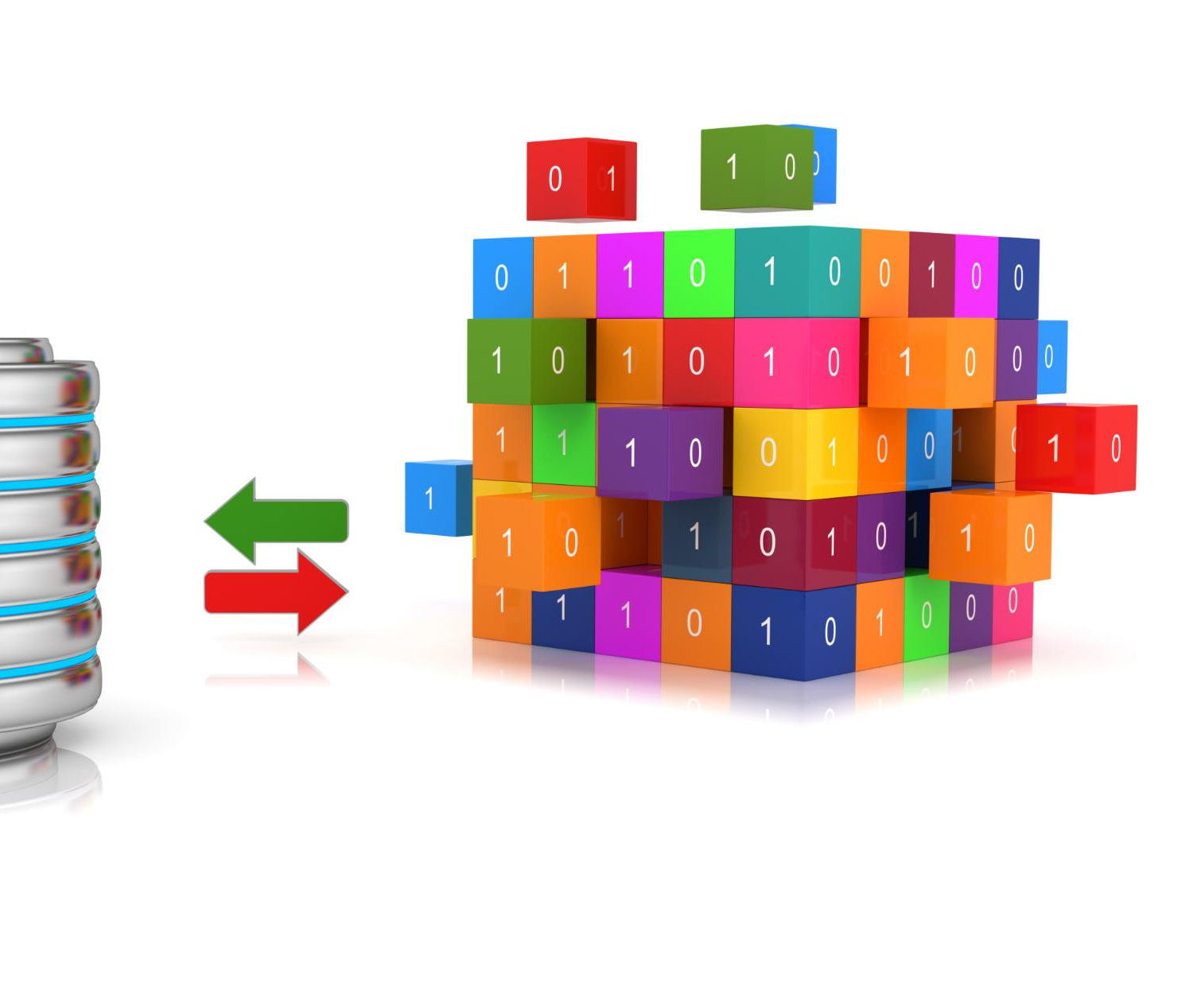
Clean, Normalize, and Connect Your Data for Effective Retrieval.
Data Cleaning
Removing errors, duplicates, and inconsistencies from raw data ensures accuracy for retrieval.
Data Normalization
Standardizing data formats and scales improves compatibility across datasets and retrieval systems.
Connecting Datasets
Establishing relationships between datasets enhances comprehensive and effective data retrieval.
Notes:
--- This content slide describes the essential steps of preparing data to optimize retrieval accuracy, including data cleaning, normalization, and establishing connections between datasets. Image source: Microsoft 365 content library

Slide 18
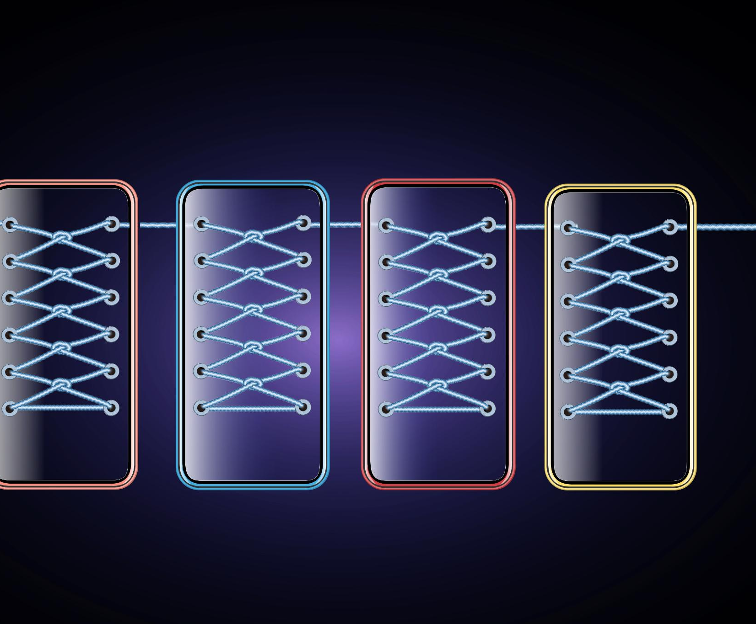
Visual: Data Pipelines Graphic
Data Preparation Process
Data pipelines organize and prepare data efficiently for integration into RAG systems.
Data Integration Flow
Data pipelines integrate diverse data sources into a unified system for analysis.
Notes:
--- A graphic illustrating data pipelines provides clarity on the processes involved in preparing and integrating data for RAG systems. Image source: Microsoft 365 content library

Slide 19
Model Development
Notes:
This section covers building robust RAG pipelines leveraging LlamaIndex, focusing on how to architect and develop models that seamlessly integrate retrieval with generation.

Slide 20

Leverage LlamaIndex to Build Robust RAG Pipelines.
LlamaIndex Utilization
LlamaIndex enables efficient access to relevant knowledge for AI applications by organizing data retrieval processes.
RAG Pipeline Construction
Combining retrieval and generation techniques enhances AI output accuracy and relevance in RAG pipelines.
Improved AI Outputs
Efficient knowledge retrieval combined with generation leads to more robust and context-aware AI responses.
Notes:
--- We highlight how to utilize LlamaIndex capabilities to construct pipelines that efficiently combine retrieval of relevant knowledge with generation for improved AI outputs. Image source: Microsoft 365 content library

Slide 21
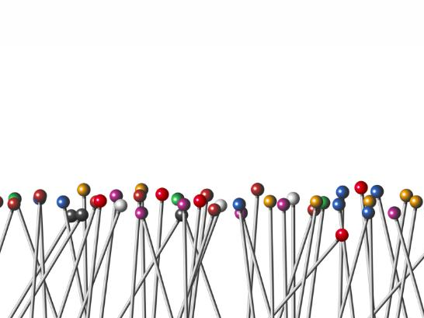
Visual: Neural Network Diagram
Neural Network Architecture
The diagram shows nodes and layers representing the structure of the AI model's neural network.
Retrieval and Generation Components
The diagram illustrates interaction between retrieval and generation components within the AI system.
Notes:
--- A neural network diagram visualizes the underlying AI model architecture, aiding understanding of how retrieval and generation components interact within the system. Image source: Microsoft 365 content library

Slide 22
Agentic Behaviors
Notes:
This section explores designing agents capable of autonomous, context-aware decision-making, which elevates RAG systems beyond simple question answering to proactive AI systems.

Slide 23

Design Agents for Autonomous, Context-Aware Decisions.
Agentic Behavior Implementation
Techniques enable AI agents to act autonomously and take initiative in complex situations.
Adaptation to New Information
AI systems adapt swiftly to changing contexts by integrating new data effectively.
Informed Decision-Making
Agents make context-aware decisions based on dynamic environmental inputs.
Notes:
--- We discuss techniques for implementing agentic behaviors that allow AI systems to take initiative, adapt to new information, and make informed decisions in dynamic environments. Image source: Microsoft 365 content library

Slide 24

Visual: Robot/Agent Making Choices
Autonomous Decision-Making
The robot symbolizes advanced autonomous decision-making capabilities in modern AI systems.
Symbolic Representation
The illustration represents the concept of agents independently evaluating and selecting options.
Notes:
--- An illustration of a robot or agent making choices symbolizes the autonomous decision-making capabilities being developed within these RAG systems. Image source: Microsoft 365 content library

Slide 25
Training and Optimizing
Notes:
This section covers best practices for tuning and optimizing RAG systems to enhance performance, including training strategies and evaluation metrics.

Slide 26
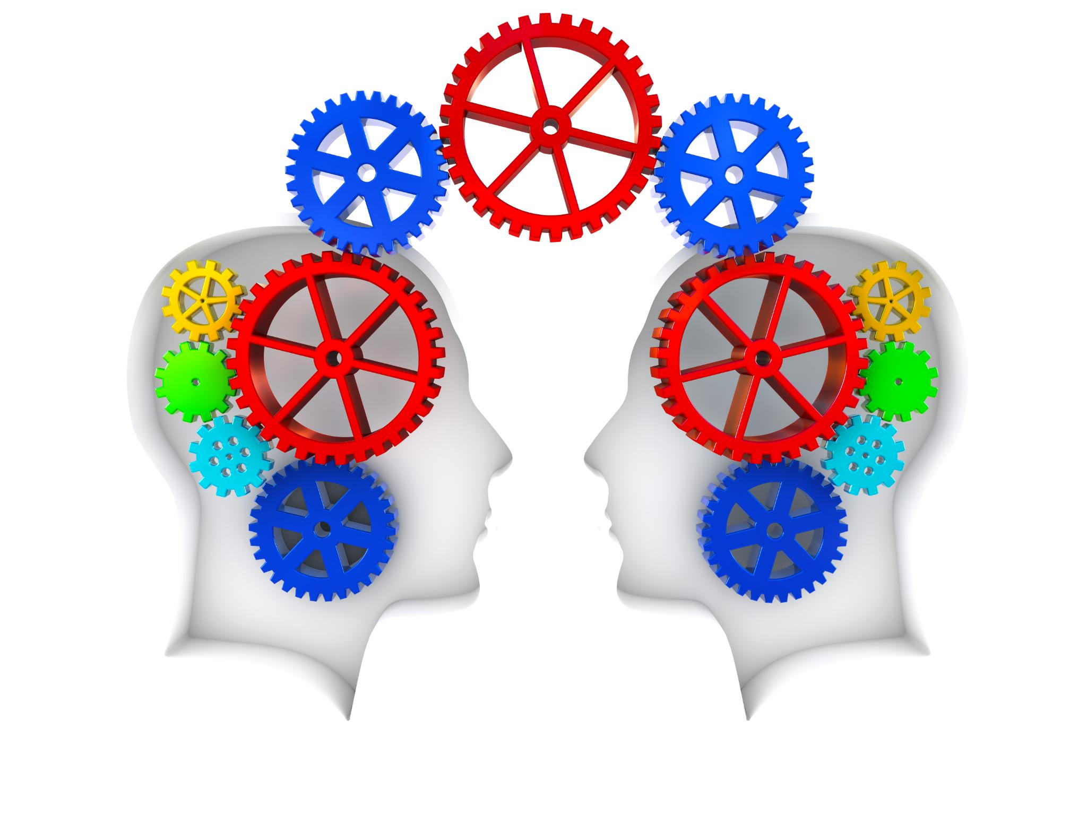
Use Best Practices to Tune Performance Efficiently.
Hyperparameter Tuning
Adjusting model hyperparameters systematically improves accuracy and performance.
Dataset Augmentation
Expanding training data with augmented samples enhances model robustness.
Iterative Testing
Repeated testing and refinement cycles boost model responsiveness and quality.
Notes:
--- We emphasize techniques such as hyperparameter tuning, dataset augmentation, and iterative testing to refine model accuracy and responsiveness. Image source: Microsoft 365 content library

Slide 27

Visual: Training Dashboard or Optimization Chart
Model Improvement Visualization
Training dashboards visually demonstrate the iterative improvement of models over time during the training process.
Performance Monitoring
Optimization charts help monitor model performance and highlight key metrics for evaluation and adjustment.
Notes:
--- Visuals of training dashboards or optimization charts help illustrate the iterative process of model improvement and performance monitoring. Image source: Microsoft 365 content library

Slide 28
Implementing RAG Systems
Notes:
This section guides the application of concepts to create and deploy full-fledged agentic RAG solutions suitable for real-world scenarios.

Slide 29

Apply Concepts to Create and Deploy Agentic RAG Solutions.
System Architecture Design
Designing robust architecture is crucial for supporting agentic RAG solutions effectively and reliably.
Deployment Strategies
Choosing scalable deployment methods ensures continuous availability and performance of RAG systems.
Reliability and Scalability
Implementing best practices guarantees system reliability and scalable growth under varying loads.
Notes:
--- We cover practical steps from system architecture design to deployment strategies that ensure reliability and scalability of agentic RAG systems. Image source: Microsoft 365 content library

Slide 30
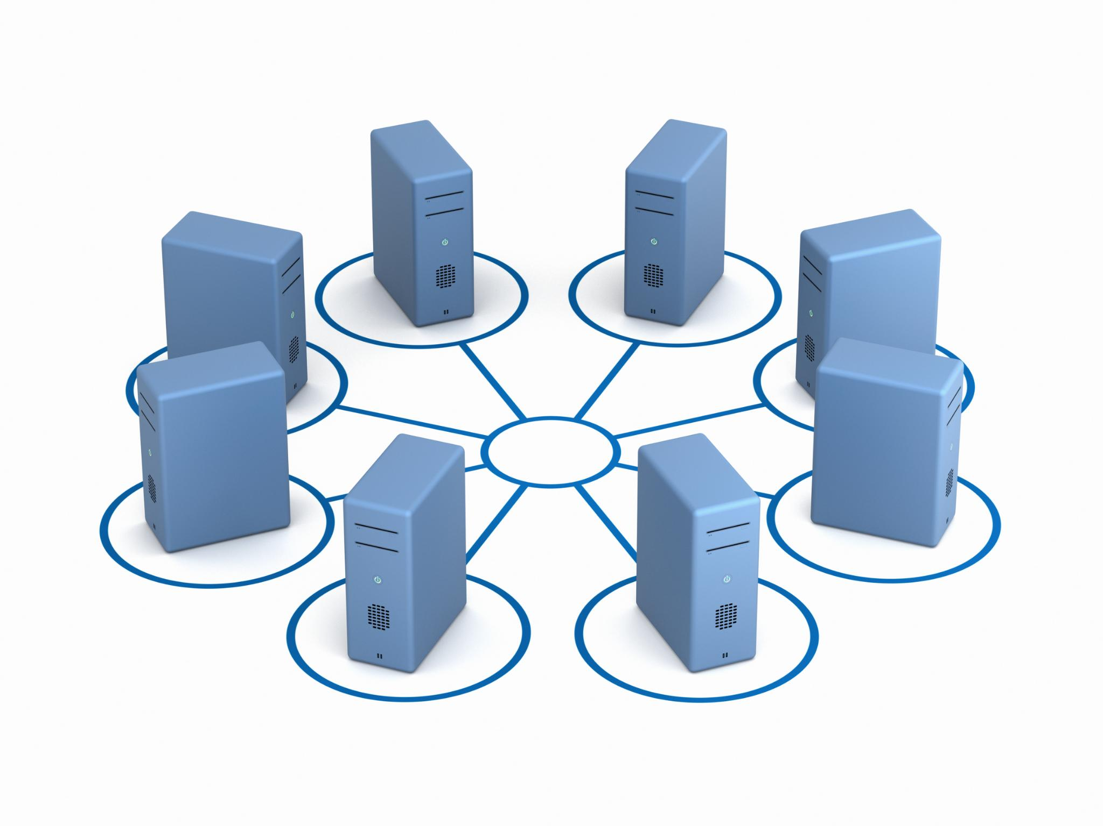
Visual: System Architecture Diagram
Component Visualization
The architecture diagram clearly shows individual system components and their relationships.
Data Flow Representation
Data flow between components is visualized to clarify process interactions within the system.
Simplified Understanding
The diagram enhances comprehension by simplifying complex system interactions visually.
Notes:
--- A system architecture diagram visually presents the components and data flow within a deployed agentic RAG system, enhancing comprehension. Image source: Microsoft 365 content library

Slide 31
Evaluation and Iteration
Notes:
This section focuses on assessing system results, refining models based on feedback, and repeating improvements to ensure continuous enhancement.

Slide 32
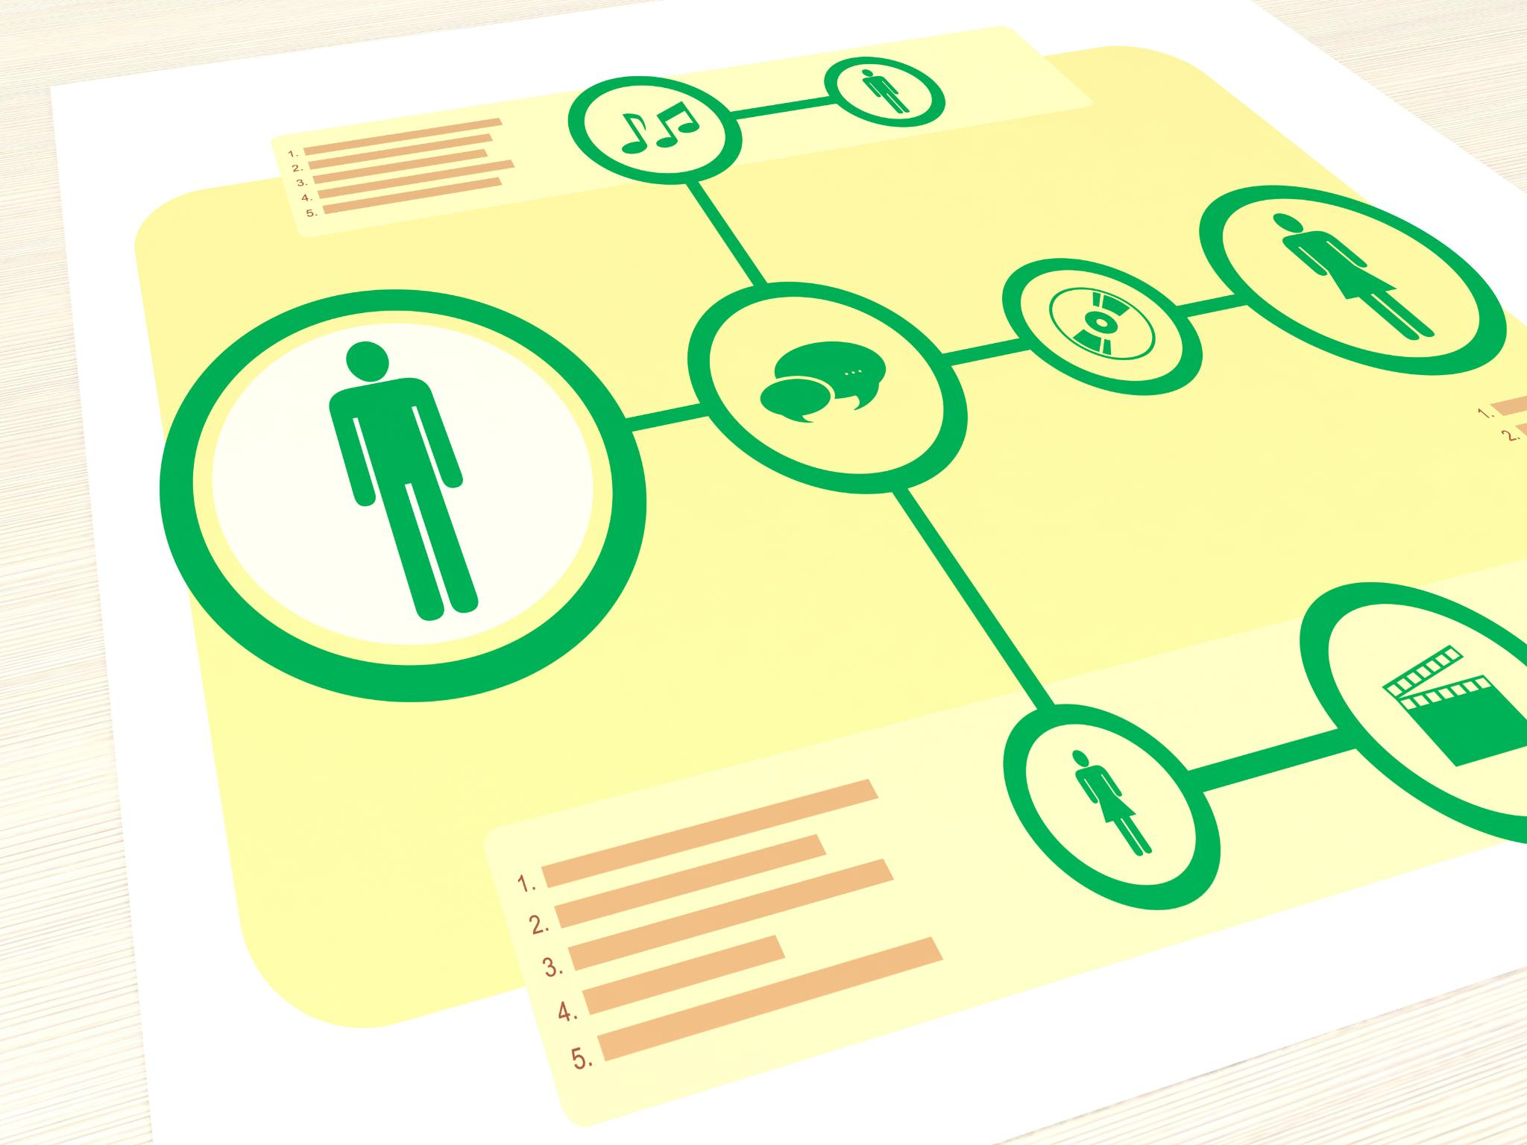
Assess Results, Refine Models, and Repeat Improvements.
Evaluation Metrics Importance
Evaluation metrics measure system performance and guide improvements effectively.
User Feedback Integration
User feedback provides valuable insights to refine models and meet user needs.
Iterative Development Cycles
Iterative cycles enable continuous improvements and system optimization over time.
Notes:
--- We highlight the importance of evaluation metrics, user feedback, and iterative development cycles to optimize system effectiveness over time. Image source: Microsoft 365 content library

Slide 33
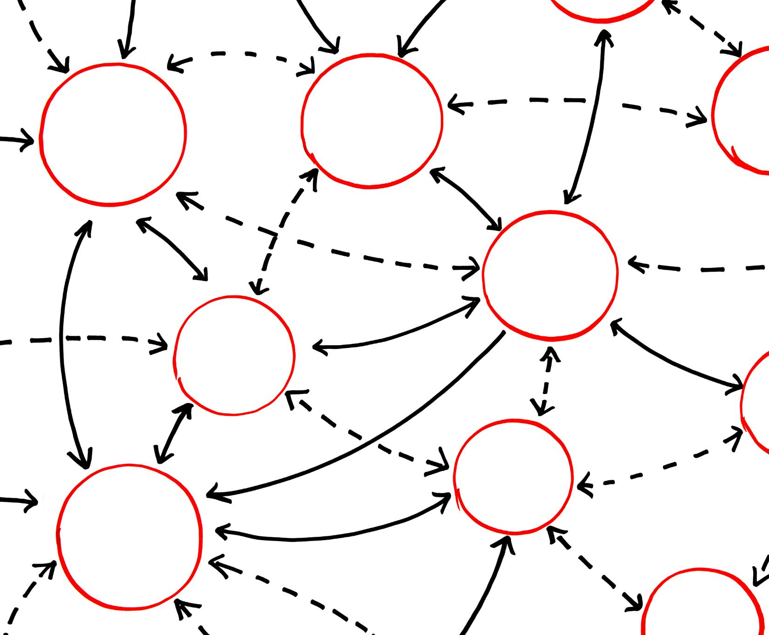
Visual: Feedback Loop Illustration
Cycle of Feedback
Feedback loops illustrate continuous evaluation and improvement in development processes.
Model Evaluation
Evaluation is a critical step to assess model performance before iteration.
Iterative Improvement
Iteration uses feedback to refine and enhance models continuously.
Notes:
--- A feedback loop illustration helps demonstrate the cyclical nature of evaluation and iteration in model development. Image source: Microsoft 365 content library

Slide 34
Advanced Topics
Notes:
Explore cutting-edge areas such as real-time data integration, reinforcement learning, and multi-agent setups that extend the capabilities of agentic RAG systems.

Slide 35

Explore Real-Time Data, RL, and Multi-Agent Setups.
Real-Time Data Integration
Techniques allow RAG systems to process and respond to changing data instantly in dynamic environments.
Reinforcement Learning Applications
Reinforcement learning enables agents to learn optimal actions through interaction with their environment.
Multi-Agent Collaboration
Multiple agents coordinate and cooperate to solve complex tasks and improve system performance.
Notes:
--- This content highlights emerging techniques and architectures that enable RAG systems to handle dynamic environments and collaborative agent scenarios. Image source: Microsoft 365 content library

Slide 36

Visual: Futuristic AI Network
Advanced AI Systems
The visual highlights advanced AI systems interconnected by a complex digital network, symbolizing cutting-edge technology.
Intelligent Agentic Models
Represents the future direction of intelligent agentic RAG models with autonomous decision-making capabilities in networks.
Notes:
--- A futuristic AI network visual represents advanced interconnected systems and the future direction of intelligent agentic RAG models. Image source: Microsoft 365 content library

Slide 37
Project Workshop
Notes:
In this hands-on workshop, participants apply skills collaboratively to build agentic RAG systems, reinforcing learning through practical experience.

Slide 38

Apply Skills in a Hands-On, Collaborative Project.
Encouraging Teamwork
Collaborative projects foster teamwork by bringing individuals together to achieve common goals.
Practical Application
Hands-on projects allow learners to apply skills in real-world scenarios, enhancing understanding and retention.
Benefits of Collaborative Learning
Collaborative learning improves problem-solving skills and promotes shared knowledge among participants.
Notes:
--- This slide encourages teamwork and practical application, emphasizing the benefits of collaborative learning and real-world problem solving. Image source: Microsoft 365 content library

Slide 39

Visual: Team Collaboration Photo or Illustration
Teamwork Symbolism
The image symbolizes effective teamwork and collective problem solving to boost engagement.
Engagement Through Collaboration
Collaborative visuals inspire active participation and social interaction within the workshop.
Notes:
--- The visual depicts teamwork and collaboration to inspire engagement and highlight the social aspects of the workshop experience. Image source: Microsoft 365 content library

Slide 40
Benefits of Agentic RAG
Notes:
We conclude by summarizing the key benefits of agentic RAG systems: enhanced decision speed, improved reliability, and significant business impact through smarter AI solutions.

Slide 41

Boost Decision Speed, Reliability, and Business Impact.
Faster Decision Making
Agentic RAG systems streamline data processing resulting in quicker organizational decisions.
Enhanced Decision Reliability
These systems improve decision accuracy through reliable data aggregation and analysis.
Driving Business Growth
Improved decision speed and reliability contribute to innovation and measurable business growth.
Notes:
--- This final content slide emphasizes how agentic RAG systems empower organizations with faster, more accurate decision-making that drives growth and innovation. Image source: Microsoft 365 content library

Slide 42

Visual: Business Growth or Performance Chart
Visualizing Business Growth
Charts effectively display upward trends reflecting business expansion and success over time.
Performance Metrics Representation
Performance charts highlight key metrics demonstrating improved efficiency and results with agentic RAG systems.
Reinforcing Value Proposition
Visual charts strengthen the communication of benefits provided by advanced agentic RAG technologies.
Notes:
--- A business growth or performance chart visualizes the positive outcomes achievable with agentic RAG systems, reinforcing the value proposition. Image source: Microsoft 365 content library

Slide 43
Conclusion
Agentic RAG Systems
Building agentic RAG systems enhances AI with autonomous and context-aware decision-making abilities.
Augmenting AI Capabilities
LlamaIndex offers powerful tools to augment AI and enable intelligent, impactful solutions.
Transforming Data into Action
Mastering these concepts allows development of AI solutions that convert data into intelligent action.
Notes:
Building agentic RAG systems with LlamaIndex offers powerful ways to augment AI capabilities for autonomous, context-aware decision-making. By mastering the concepts and tools presented, you can develop impactful AI solutions that transform data into intelligent action.

